Slide 1
DevOps What it Is, What it Isn’t, and Why Coders Should Care

Slide 2
Dave Swersky
Enterprise Architect, PNC Bank
@dswersky
Notes:
How many of you heard of DevOps for the first time within the last year?
Who’s Dev? Who’s Ops?
Before we get to DevOps, a little history
Me
PNC
DevOps Research
Conferences

Slide 3



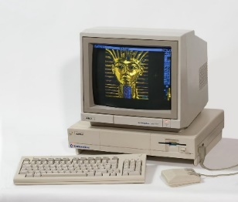
1995:
Industry Hero
We Can Do IT!
Notes:
1995: The halcyon era
Computing available, democratized
Internet ascendant- “what is that Internet thing?”
IT workers changing the world, business, automating things for the first time
Must be on to something, the suits are showing up with bags of cash
We’re heroes!

Slide 4



2000:
Industry Deadbeat
We Can Do… IT?
Notes:
Always late, overbudget
Never deliver what is asked for or needed (not that the business knows the difference)
No surprise that this is when the market collapsed
We kinda feel like THIS- and it’s how our business sees us
Cost center/liability rather than enabler
We’re like insurance, needed not because we make things better but because without us the business fails
A year later, a group of smart folks get together and talk about values

Slide 5
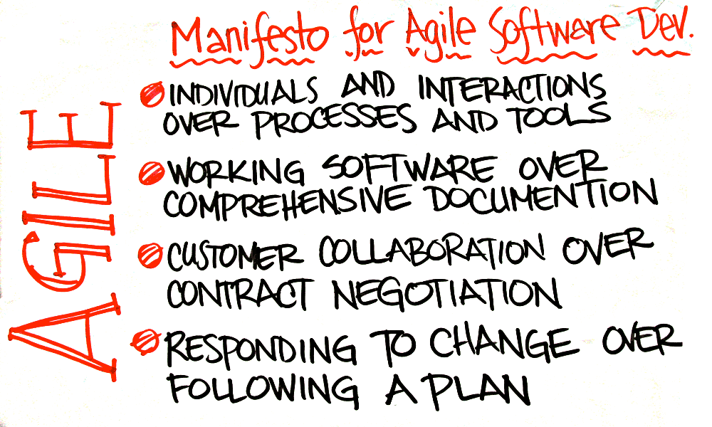
2001: Agile Manifesto
Image credit: blog.twg.ca
Notes:
Agile manifesto is drafted/signed/published and the market goes wild in short order

Slide 6



Agile?
Agile?
Agile?
Agile?
Agile?
Agile?
Agile?
AGILE! AGILE! AGILE!
Notes:
First we’re like the meerkat,
Then the birds,
And finally we all do the Ballmer

Slide 7
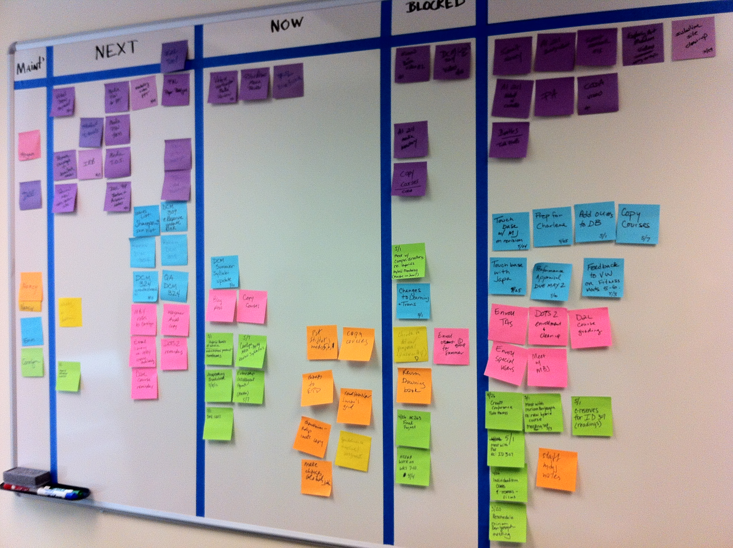

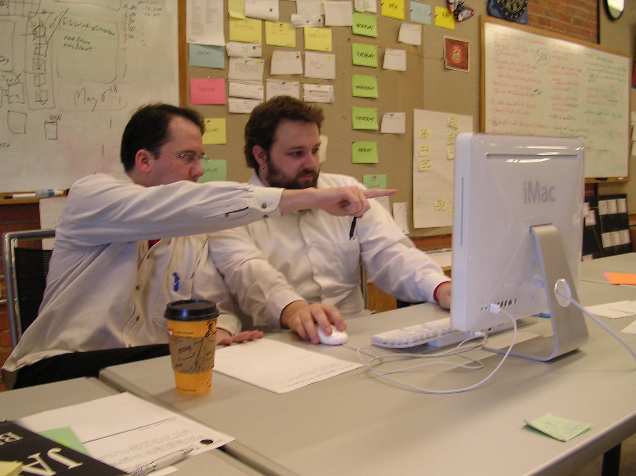
We Can Do IT (This Time!)
Credit: en.wikipedia.org

Slide 8


Agile Purism (Blech)
You Meet Standing Up?
You must be so Agile
Y U NO DO AGILE MY WAY?

Slide 9
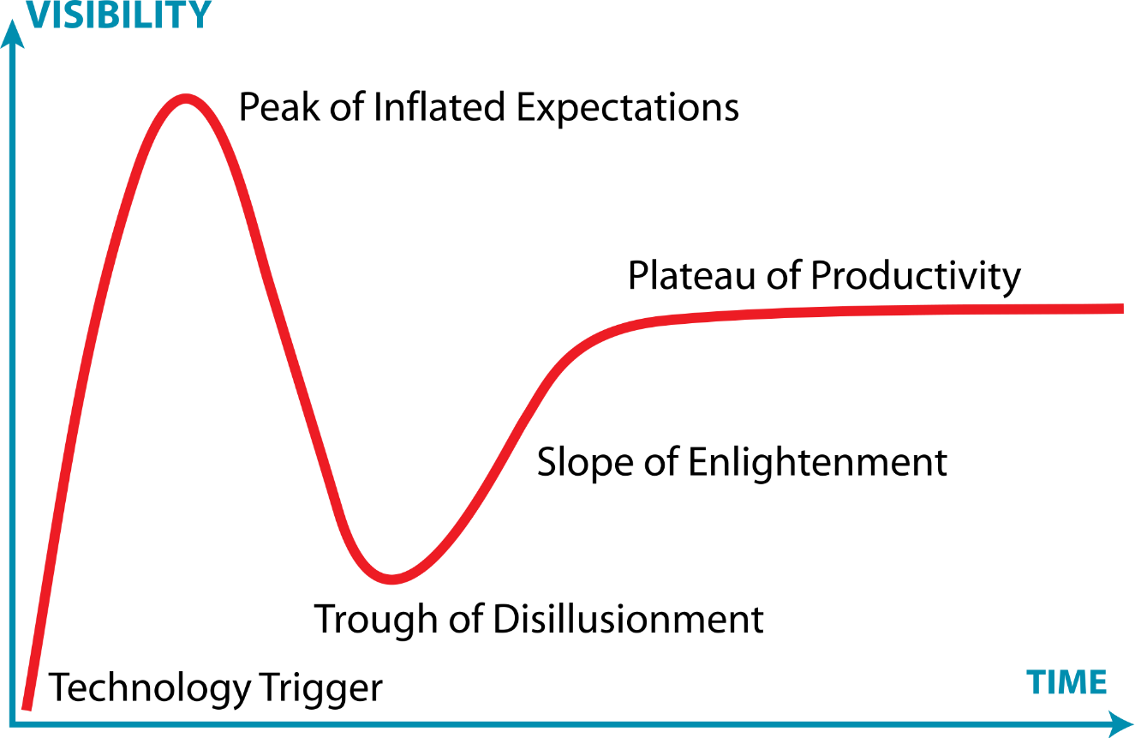

Gartner Hype Cycle
Agile
Notes:
Cast we were into the Valley of Disillusionment

Slide 10
2015: Agile is Legit
52% of survey respondents say they use Agile for the majority of their software development projects*
*2013 VersionOne “State of Agile” Survey
Notes:
Almost 15 years later, Agile has a legit place in dev teams all over the world
Methodological pinnacle- invisibility
HOWEVER… there was a problem. Agile didn’t finish the job. Agile by itself doesn’t get the ball to the endzone
Agile does a great job with development, but its current practice doesn’t have a lot to say after the code is tested and ready for deployment
So what are the other problems with software delivery? That’s the right question- the answer to those problems might just be
DEVOPS

Slide 11
Enter DevOps
Word coined in 2009 by Patrick Debois
First DevOpsDays conference held in Belgium
Concept popularized by John Allspaw and John Hammond, of Flickr, at the 2009 Velocity conference
“10 Deploys a Day!”
The Phoenix Project published in 2013
First DevOps Enterprise Summit held last October in SF
Notes:
DevOps is barely five years old, but that’s long enough to have something of a history
2009 was the trigger year: the word was coined, the meetup happened for the first time, and John Allspaw introduced the idea that multiple deploys a day could be a GOOD thing
The seminal work on the subject- The Phoenix Project
DevOps Enterprise Summit, lots of big, well-established companies
Many of you just hearing about it for the first time, why?
Longer incubation period- Agile was a dev thing, DevOps is an EVERYthing
So, after five years where are we with DevOps?

Slide 12
DevOps?

Slide 13
STAHP
(Take a breath)
Notes:
Take a deep, cleansing breath
I know you wanna see me jump around this stage again.. But no
DevOps has important things to offer, let’s not hyperventilate over it

Slide 14


DevOps: Let’s Jump The Valley
Notes:
Take a jump over the valley with me, let’s see if we can get some value from DevOps sometime before 2030
…
Not going to start with the Wikipedia definition, because it’s useless out of context
Breaking down DevOps into lessons, building to a big-picture definition

Slide 15
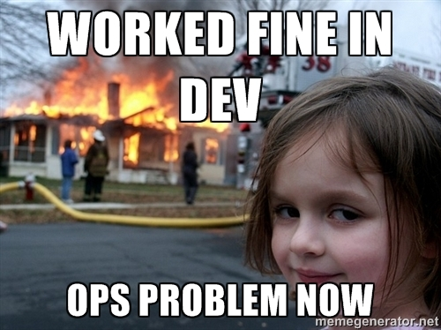

A Thousand Words on DevOps…
Lesson #1:
DevOps is about cooperation and understanding between Dev and Ops
Notes:
This is a great image- really tells the story
What’s it like being in Ops, taking on a new release (play)
Circular firing squad
Dev- Innovation/Velocity, Ops- Stability/Support
Dev and Ops are traditionally like oil & water. DevOps is the soap.
*That’s clever, what does it mean?

Slide 16
DevOps Fundamentals
Lesson #2:
DevOps is the application of Lean and Agile principles across the software delivery value stream
Lean
Agile
DevOps
Software Delivery Value Stream
Business Objectives
Product Vision
Requirements
Development
Test
Release
Support
Business
Development
Operations
Measurement / Continuous Improvement
Notes:
You can’t talk about DevOps without talking about Agile, can’t talk about Agile without talking about Lean
Lean:
what does Lean have to say about software delivery? What is Lean anyway?
Toyota Production System
Value stream
Software delivery is a value stream, and a value stream is a system
DevOps takes the principles from Agile and Lean and applies them all the way up and down the value stream
*So what are those principles?

Slide 17

DevOps Fundamentals
Lesson #3: DevOps applies Lean values to control the flow of work through the value stream
Notes:
Who can tell me what this is? Great, what’s it for?
Sure prioritizing and managing tasks, but what are the columns for? Why not just an ordered stack?
Do we want lots of work in the WIP column or a little? Why?
Controlling the flow of work- this is a Lean value
Controlling the flow of work ensures that work gets done instead of everything colliding and backing up
Lesson #3
*What’s a good example of a super-simple value stream?

Slide 18


DevOps Fundamentals
A simple Value Stream
Idle Time
Notes:
Highway: produces translation, point A to point B
Onramp = Input
Highway = Processing
Output = Offramp
Traditional orgs see idle time as Baaad… everyone should always be working furiously, as fast as possible…

Slide 19


DevOps Fundamentals
Achievement Unlocked:
100% Utilization!
Controlling the Flow
Notes:
Here’s what you get with 100% utilization
Traditional orgs see idle time as Baaad… everyone should always be working furiously, as fast as possible…
Here’s how you prevent gridlock
Key Lean insight- you can’t make a system move faster by cramming work in the front end
The work centers don’t work in isolation, they work together as a system, and a system must be tuned

Slide 20
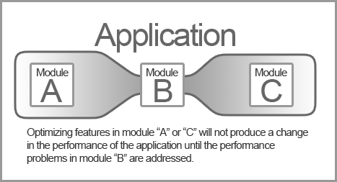
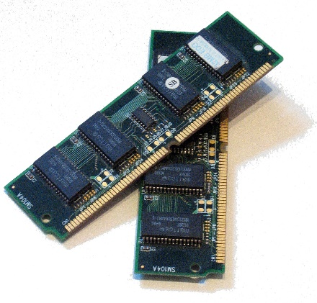
DevOps Fundamentals
Lesson #4: Efficiency improvements before or after the constraints will have no effect on throughput
Notes:
Here’s another example of the systems thinking- does adding RAM to a computer make it faster?
No? Then why was my wife thrilled when I added 2GB to her computer, bringing her to a blistering 4G?
Throughput.
Next principle: Defects
How did Ford/GM/Chrysler handle defects?

Slide 21

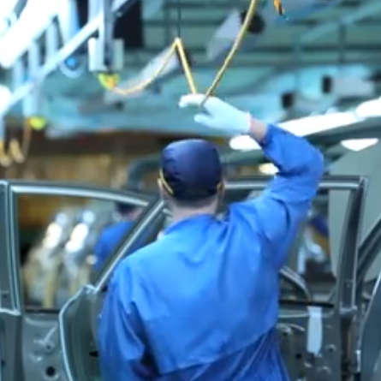
DevOps Fundamentals
“We’ll Fix it Later”
“We’ll Fix it NOW”
Lesson #5: Never allow defects to flow down the line
Notes:
Traditional, pre-Lean manufacturing handled defects by NOT handling them
Leads to parking lots full of broken cars
Lean practices teach us that stopping ALL production (in software terms, deployment) is the most efficient way to triage defects
Defects get more expensive with each move down the line, they’re never cheaper to fix than the moment they’re discovered
STOP deployment (don’t merge, don’t deploy) until the defect is fixed or AT LEAST rolled back/out
Next: COMMUNICATION

Slide 22


DevOps Fundamentals
DEV
OPS
Lesson #6: Communication, Respect, and Knowledge Sharing is critical to DevOps
Notes:
COMMUNICATION
Here’s the heart of DevOps- the non-technical, soft skill stuff
The common problem of silos- tall vertical walls between teams that prevent collaboration
SNEETCHES:
Now, the Star-Belly Sneetches
Had bellies with stars.
The Plain -Belly Sneetches had none upon thars.
The Stars were a sign of riches and wealth,
But were really so small,
You might think such a thing wouldn't matter at all.
But, because they had stars, all the Star-Belly Sneetches
Would brag, "We're the freest Sneetches walking the beaches".
With snoots in the air, they would sniff and they'd snort
"Jobs! They are for you Plain-Belly sort!"
And whenever they met some, when they were out walking,
They'd hike right on past them without even talking.
TOUGH LOVE:
We IT people aren’t the most social creatures
We tend to bristle at input even from colleagues
Get the stars off our bellies, the chips off our shoulders, and start learning how to do our jobs better from people who don’t do our jobs.
Dev peeps, Ops will give you a heaping, helping earful about how your code works (and often doesn’t) in production
Ops peeps, your developers have plenty to teach you about how to automate your systems
Getting Dev and Ops (and Networking/Security etc) pointed in the same direction allows us to achieve the WHOLE POINT of DevOps
Next up: The POINT

Slide 23

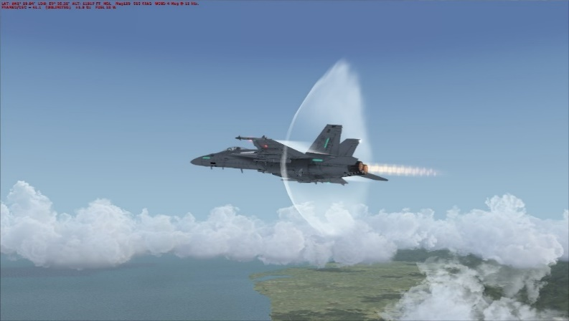
DevOps Fundamentals
Biz
Dev
Ops
+
=
Flow
Feedback
Velocity
Lesson #7: The goal of DevOps is velocity: delivering fast while maintaining quality
Notes:
FLOW + FEEDBACK = VELOCITY
Now that we know how to control the flow, and to think of software delivery as a system, what’s the point?
Velocity is the point, because that’s how you get from MBA ideas to software dollars
“Working software over comprehensive documentation” is all well and good within Dev, but meaningless until the bits are in Prod
“Common sense” says that moving fast means lower quality, that’s not the case
“Failing small and failing fast” means fewer defects going to production because changes are smaller and more incremental
Next: DevOps Summary

Slide 24
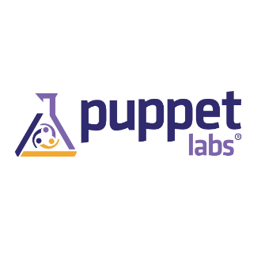




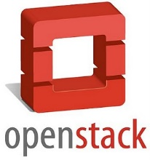




DevOps IS
Communication
Automation
Transformation
Notes:
Communication is crucial, as is the culture that fosters it
Not just cross-team, also cross-role. Up, down, across, ALL communication
Automation is the reason velocity doesn’t lead to lower quality
When I started in this industry a server meant an 80lb, $12K boat anchor
Joel Test, one click build
Not good enough anymore, today it’s the one-click deploy
IaaS, PaaS, converged infrastructure
DevOps Transformation is about adapting the basic principles in a way that makes sense for your business
Delivering these ideas to your management can be a challenge, refer to my presentation at DOES
RECAP

Slide 25


DevOps Ain’t
DevOps!
*Now with 10% more Continuous Delivery!
DevOps Guy
A Person, Team or Title
Continuous Integration/Delivery
A Product
Notes:
Vendors will sell you DevOps like a shrink-wrapped product and tell you it’s all you need
The LAST way to “do DevOps” is to tag one guy, or start the DevOps Team
DevOps plays nice with all kinds of other methodologies
Bonus ain’t: Also- it’s dependent on continuous delivery, but there’s much more. DeOps synonymous with CD like “car” is synonymous with “engine”

Slide 26
Being DevOps
DO:
Align Dev and Ops missions
Adopt Continuous Delivery/Deployment practices
Evaluate your current processes
DON’T:
Dedicate a new silo called the “DevOps Team”
Try to buy DevOps “off the shelf”
Dictate DevOps from the top down (or the bottom up)
Notes:
DevOps isn’t a verb, it’s an adjective, like Agile
Now that you have some ideas what it is, you can change your behavior if DevOps appeals
DO:
Everybody on the same team, pointed in the same direction
DevOps is essentially impossible without CD – velocity is the point, without CD there is no velocity
Heat-treat story
DON”T:
The only thing worse than no DevOps is a new silo
DevOps isn’t a solution, it’s a practice. Buy the tools, but don’t use them as a crutch/excuse
Don’t try to dictate, develop your DevOps practice in an Agile way. Iterate

Slide 27
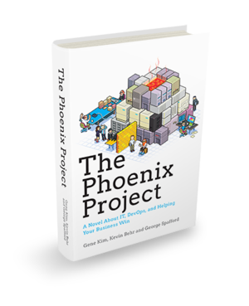

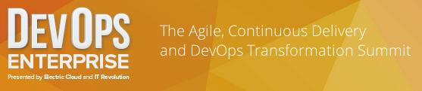
Homework
Notes:
HOMEWORK
The “lessons” here are generally aligned to the Three Ways described in The Phoenix Project
The Phoenix Project was inspired by The Goal
This is not bedtime reading- I started the Phoenix Project at a conference in San Fran last April, missed a whole day of sessions unable to stop reading
Read them in this order and they’ll change the way you think about delivering software
Then, watch the videos on the DOES YouTube channel to learn how the largest companies in the world apply DevOps to their software delivery (play my video at half speed!)
Now, why do I care about all this stuff? Isn’t it just the new shiny object?

Slide 28









DevOps Is Coming
Brace Yourself
DevOps Is Coming
Notes:
“DevOps is Coming”
How do you know, Dave? S&P 500 starter
DevOps is progressive stuff, what’s the LAST type of entity you’d expect to take it up? How about the government?
And.. a few other smaller companies here and there
Unicorns/Horses

Slide 29

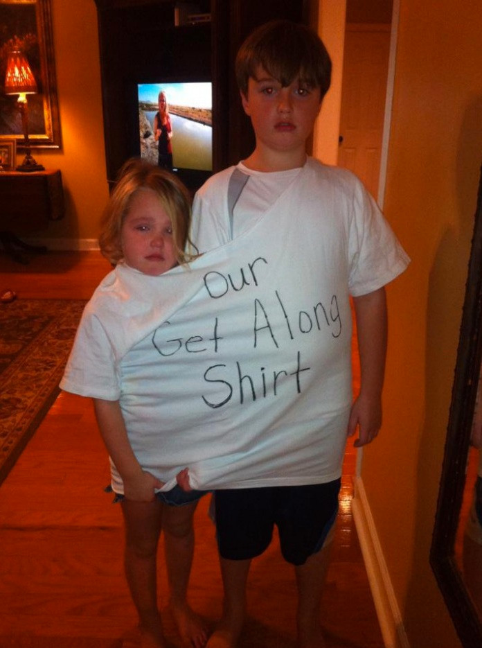
If You Don’t, He Will
OPS
DEV
“I know all about OpsDev!”
Notes:
Since it’s coming, you want to get ahead of the curve
If you let this guy do your DevOps for you, if you’re lucky THIS is the DevOps you’ll get
Lucky because this guy only knows what the vendors tell him, they can’t make any money of the human/collaboration aspect
If you’re not lucky, this guy will tell everyone “we’re a DevOps shop” because you use Chef.
Even if pointy-hair guy DOES get AND want the human aspect, he can’t force it on us
We have to want it
We have to take ownership of the “bottom-up,” human aspects of DevOps for a transformation to be successful

Slide 30
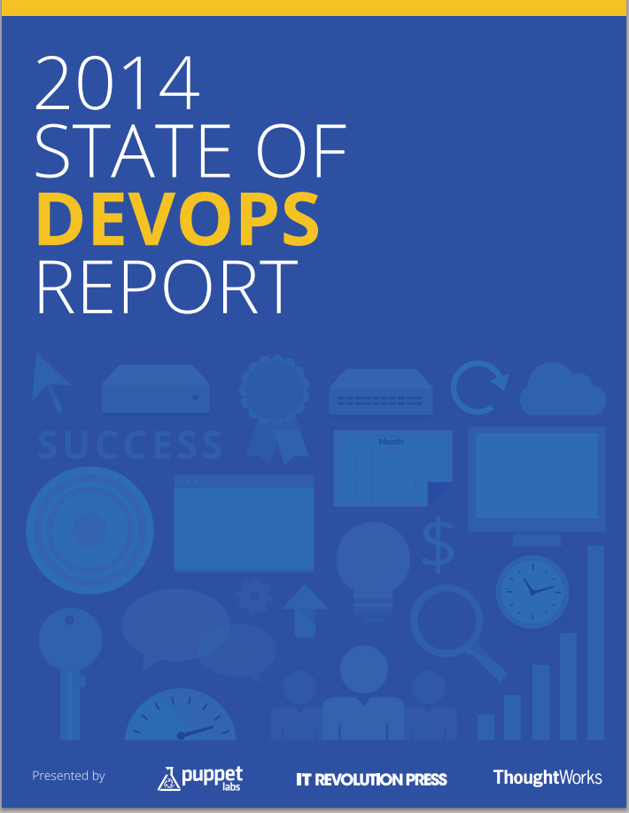
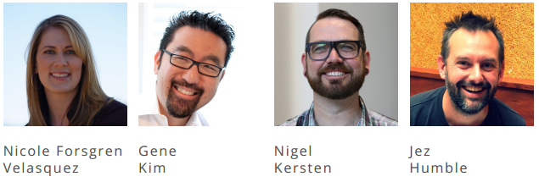
You Need DevOps
High-Performing IT Organizations:
2x more likely to exceed market share and productivity goals
50% higher market cap growth over 3 years
http://puppetlabs.com/sites/default/files/2014-state-of-devops-report.pdf
Notes:
Dr. Forsgren and the Productivity Paradox
During that heyday of 1995, IT became an integral part of essentially every business on earth
One would think that all that automation and computerization would make things more efficient, leading to a measurable increase in productivity.
Turns out this didn’t happen- academics measure these things, and for decades it has been so difficult to find a positive correlation between IT spend and the bottom line, it’s now a thing- the Productivity Paradox
One of the most impactful presentations at DOES was delivered by Dr. Nicole Forsgren of the Huntsman School of Business at Utah State University
Dr. Forsgren, working with Gene Kim (co-author of the Phoenix Project) Puppet Labs, and Jez Humble, conducted a study of the state of DevOps in 2014.
For the first time, possibly ever, there is a study indicating direct, immediate correlation between IT spend and revenue as stated on the 10K.
REPEAT

Slide 31

You Want DevOps
Notes:
We’ve all been in the Dilbert cube farm
We’ve all been in the six-week death march
Death marches (darkened conference rooms, filled with devs shoulder to shoulder, hunched over screens, smelling of pizza and desperation) and overtime come from misaligned, poorly tuned organizations where communication is stifled
What is the opposite of this?

Slide 32
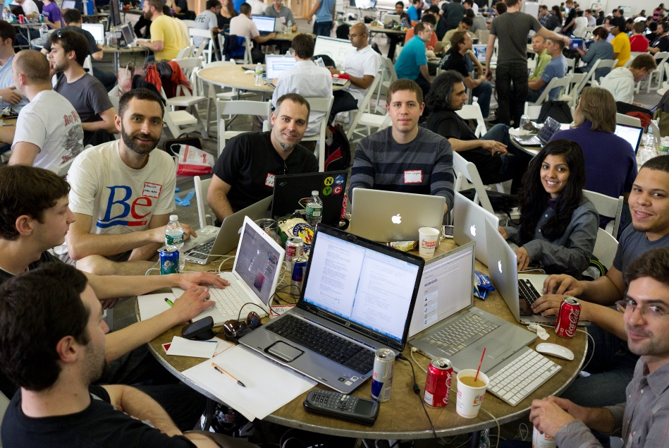
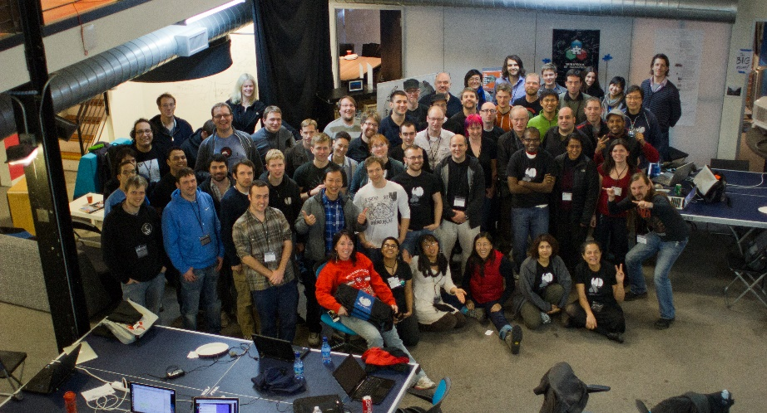
You Want DevOps
Notes:
These hackathon participants are having fun, enjoying each other’s company, and getting things done
What does a hackathon have to do with DevOps? These folks are going from concept to PRODUCTION in a day or two. How cool is that?
Obviously, that’s not strictly practical in any business setting but it is instructive- the better you align everyone to the goal, the better tuned the machine, the happier everyone is

Slide 33
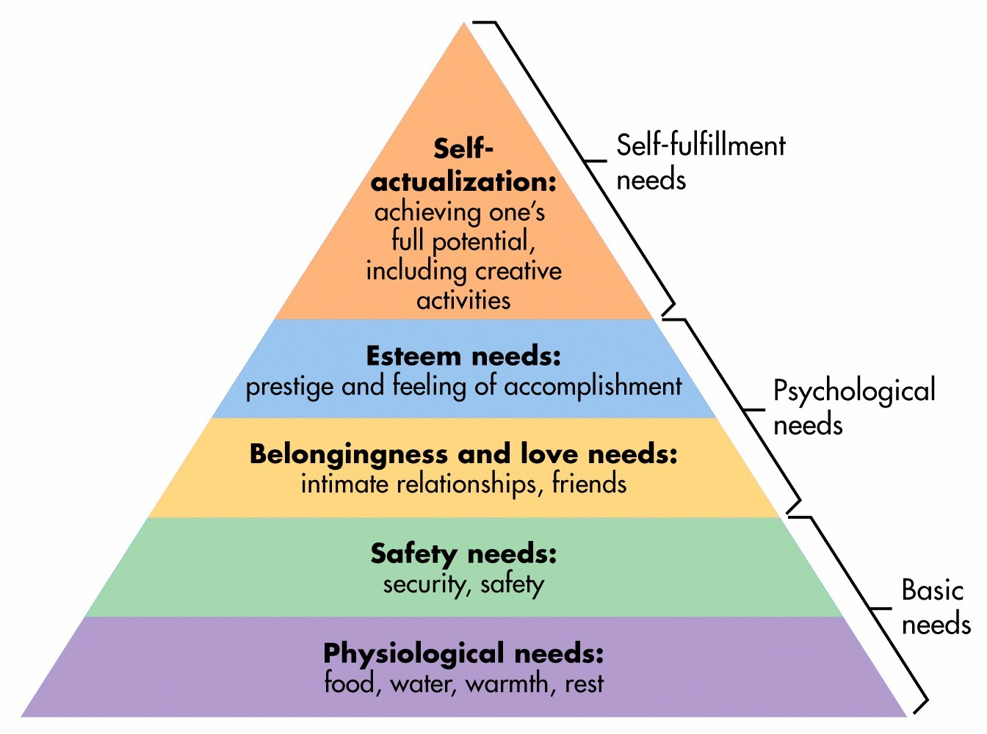
You Want DevOps A Life!
http://figur8.net/baby/2014/11/06/maslows-hierarchy-of-needs-and-how-it-relates-to-your-childs-education/
Notes:
DevOps is not about a product or a technology, at the end of the day it’s about people- US!
I’ve also been lucky enough to work for some people who really inspire me, made me want to work harder and better
The Goal and The Phoenix Project are not dry textbooks filled with theory. They’re about people who just want to get home to the family (or the XBOX)
We work to get paid, but that’s not the whole story- we’re creative problem solvers that live for the challenge
DevOps is a means to an end- that end is a business making money.
That leads to happy executives, happy customers, and happy IT people who can deliver all the things in 40 hours a week

Slide 34
Appendix
DevOps.com
http://devops.com
DevOps Organizational Topologies
http://blog.matthewskelton.net/2013/10/22/what-team-structure-is-right-for-devops-to-flourish/
How To Visualize a Process With a Value Stream Map
http://www.goleansixsigma.com/how-to-visualize-a-process-with-a-value-stream-map/
How are Lean, Agile, and DevOps related to each other?
http://www.agileweboperations.com/lean-agile-devops-related
2014 State of DevOps Report
http://puppetlabs.com/sites/default/files/2014-state-of-devops-report.pdf
DevOps, Cloud, and the Lean “Wheel of Waste”
http://seroter.wordpress.com/2014/04/07/devops-cloud-and-the-lean-wheel-of-waste/
The Phoenix Project
http://www.amazon.com/The-Phoenix-Project-Helping-Business/dp/0988262592

